Slide 1

Kettle Tutorial –
Configurar Acesso BD

Slide 2
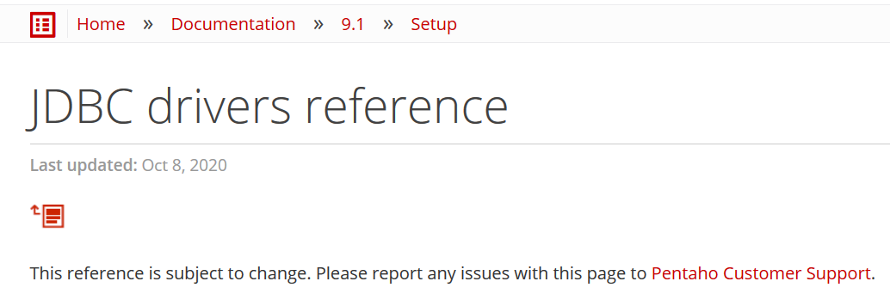
JDBC drivers reference
    https://help.pentaho.com/Documentation/9.1/Setup/JDBC_drivers_reference#r_pentaho_postgresql_jdbc_drivers_reference

Slide 3
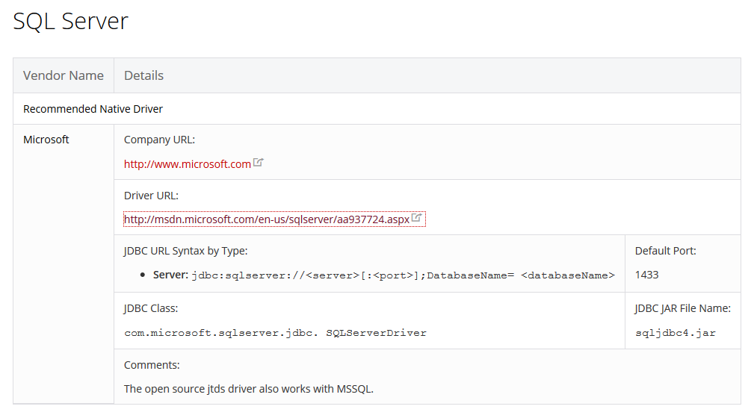
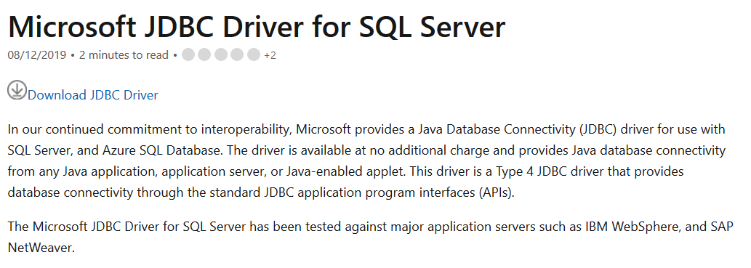
JDBC drivers reference - SQL Server
Driver URL: http://msdn.microsoft.com/en-us/sqlserver/aa937724.aspx

Slide 4
JDBC drivers reference - SQL Server
Driver URL: http://msdn.microsoft.com/en-us/sqlserver/aa937724.aspx
- Descompactar numa pasta temporária.
- Copiar o ficheiro de '<pasta_temporaria>\sqljdbc_6.0\enu\jre8\sqljdbc42.jar'
para '<pasta de instalação do PDI>\data-integration\lib'

Slide 5
JDBC drivers reference - SQL Server
Driver URL: http://msdn.microsoft.com/en-us/sqlserver/aa937724.aspx
- para utilizar segurança/autenticação integrada devem copiar de '<pasta_temporaria>\sqljdbc_6.0\enu\auth\x64\sqljdbc_auth.dll'
para 'C:\Programas\Java\jre??\bin' (64-bit)
Ou se for na versão 32 bits Copiar de '<pasta_temporaria>\sqljdbc_6.0\enu\auth\x86\sqljdbc_auth.dll'
para 'C:\Programas (x86)\Java\jre??\bin' (32-bits)

Slide 6
JDBC drivers reference - SQL Server
Driver URL: http://msdn.microsoft.com/en-us/sqlserver/aa937724.aspx
Abrir o Spoon e Testar a ligação
- Se tiverem problemas, verifiquem, pf, se o TCP/IP está ativo através do MS SQL Server Configuration Manager.
Se não conseguirem executar esta ferramenta, consultar pf
https://docs.microsoft.com/en-us/sql/relational-databases/sql-server-configuration-manager?view=sql-server-2017

Slide 7
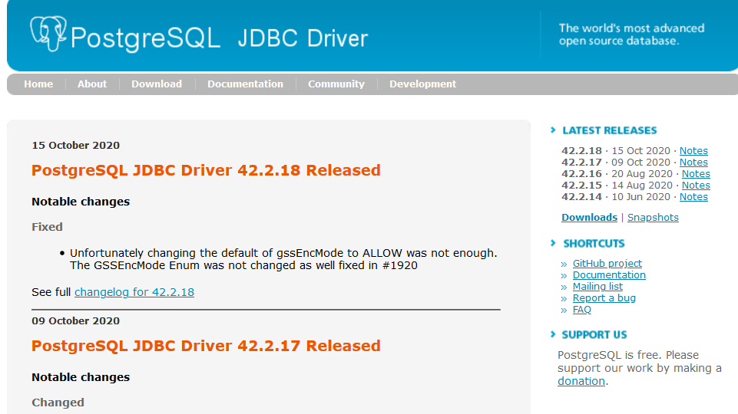
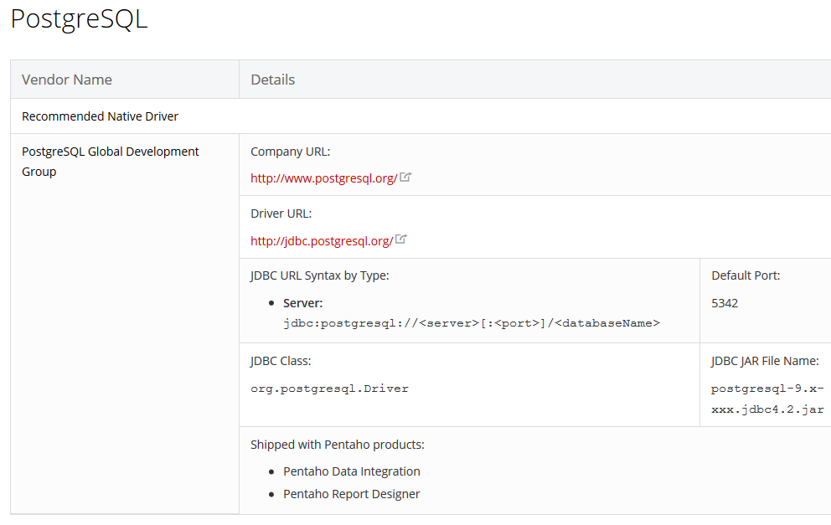
JDBC drivers reference - PostgreSQL
Driver URL: http://jdbc.postgresql.org/

Slide 8
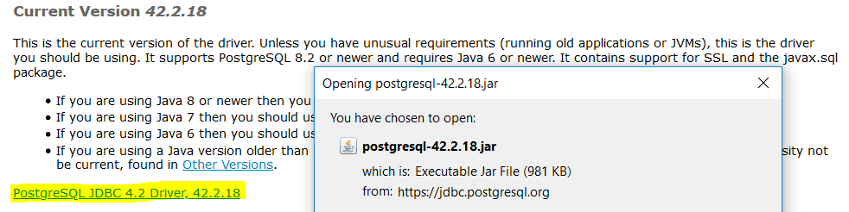
JDBC drivers reference - PostgreSQL
Download: https://jdbc.postgresql.org/download/postgresql-42.2.18.jar
\

Slide 9
JDBC drivers reference - PostgreSQL
Download: https://jdbc.postgresql.org/download/postgresql-42.2.18.jar
Copiar para '<pasta de instalação do PDI>\data-integration\lib'

Slide 10
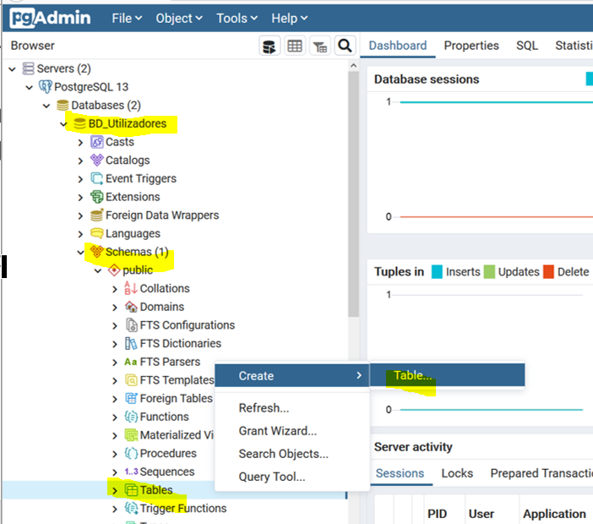
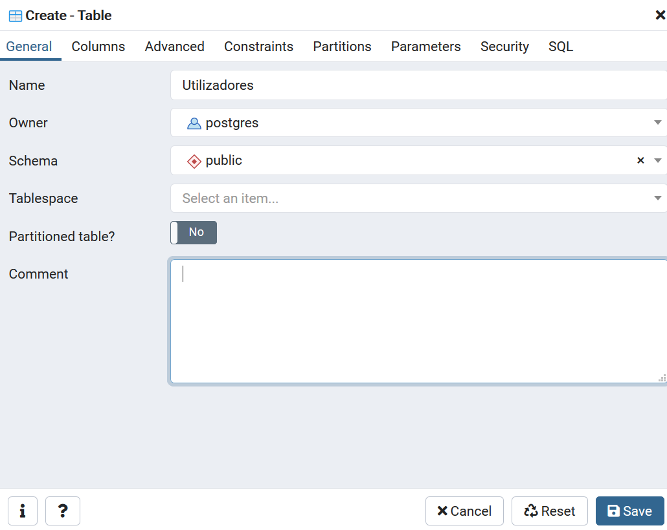
pg Admin 4
to create a new table, Select a database from the tree control, select the schema under the database, right-click on the Tables node, and select Create Table…

Slide 11
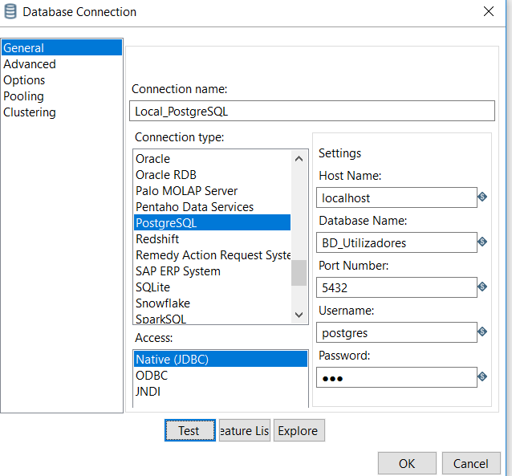
FILE > New > database connection…

Slide 12
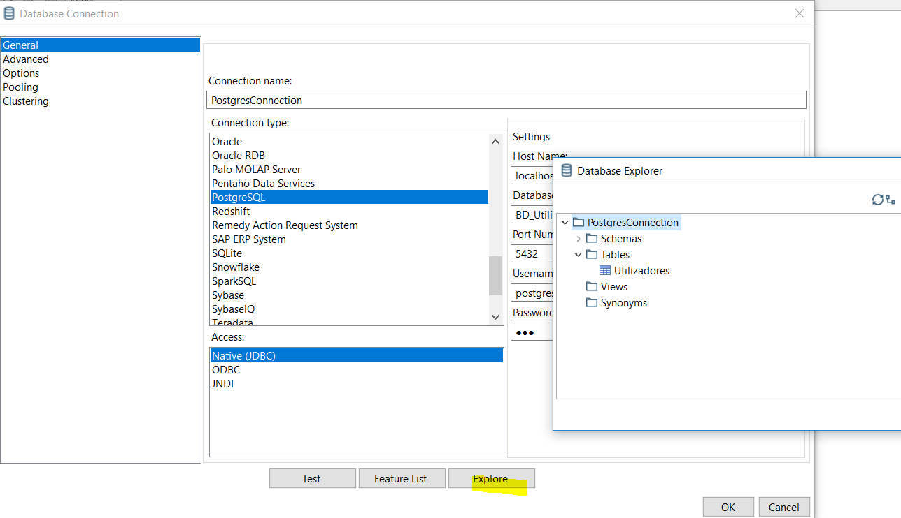
FILE > New > database connection…

Slide 13
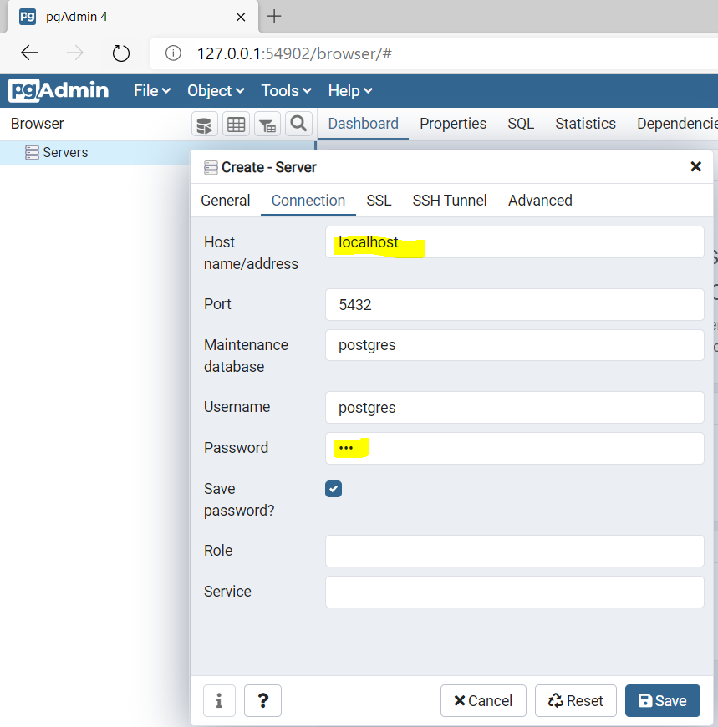
JDBC drivers reference - PostgreSQL
Download: https://jdbc.postgresql.org/download/postgresql-42.2.18.jar
PgAdmin
http://127.0.0.1:49854/?key=6a3f3638-1503-4d9d-8102-ae0cda10beb2

Slide 14
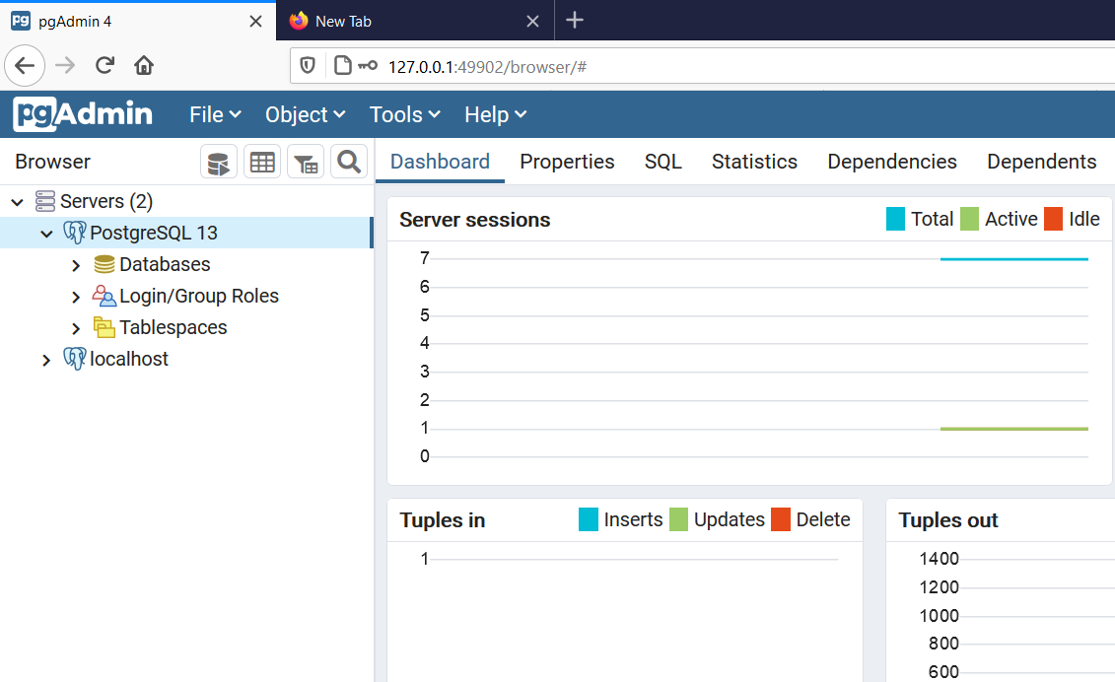
JDBC drivers reference - PostgreSQL
Download: https://jdbc.postgresql.org/download/postgresql-42.2.18.jar
PgAdmin
http://127.0.0.1:49854/?key=6a3f3638-1503-4d9d-8102-ae0cda10beb2

Slide 15
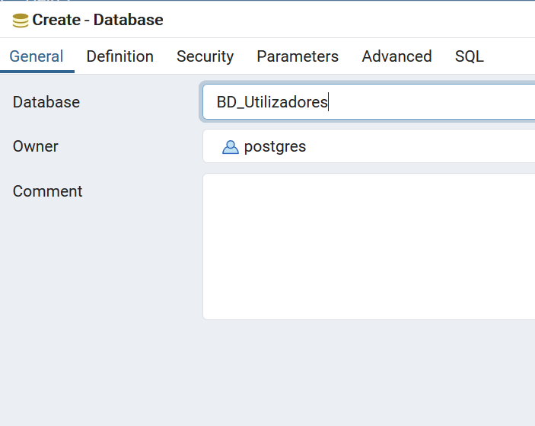
Object > Create Database…

Slide 16
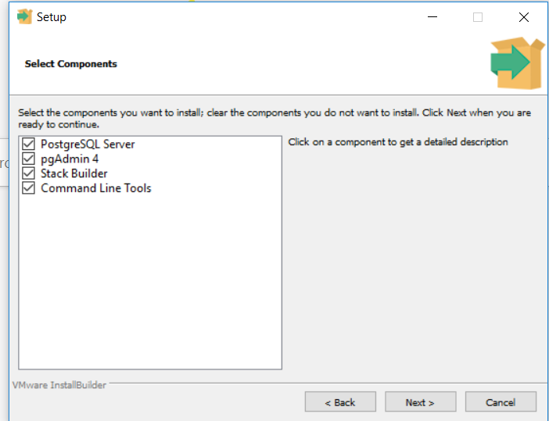

Slide 17
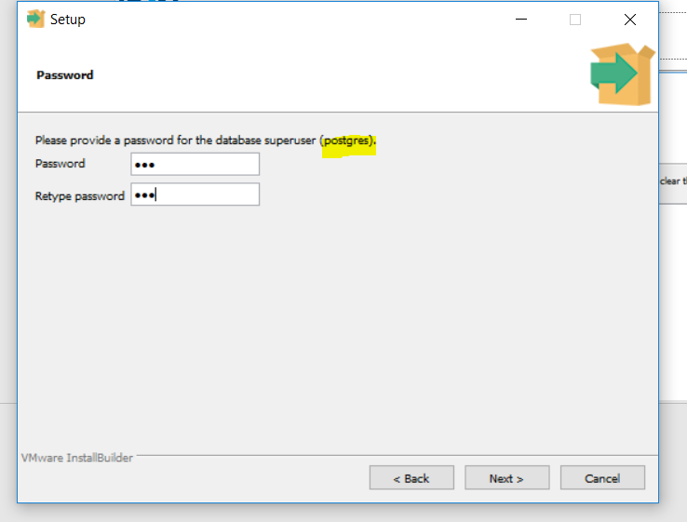
Password: 123
Port: 5432

Slide 18
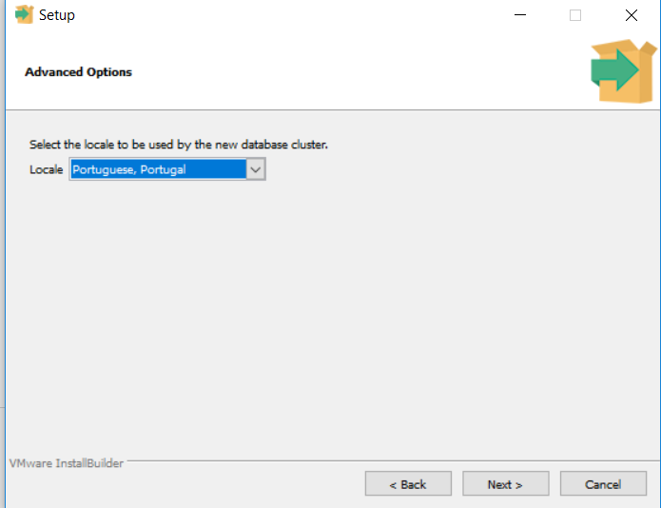

Slide 19
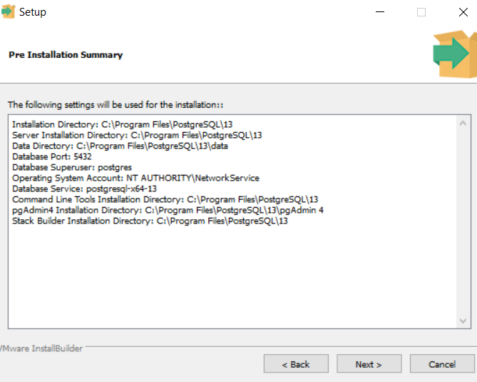

Slide 20
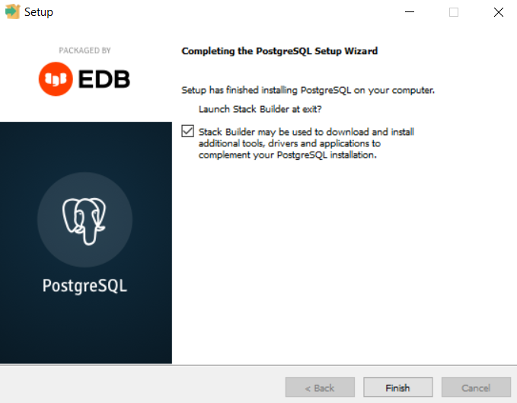

Slide 21
JDBC drivers reference - MySQL
MySQL Download: https://dev.mysql.com/downloads/installer/
Driver (conector) URL: https://www.mysql.com/products/connector/

Slide 22
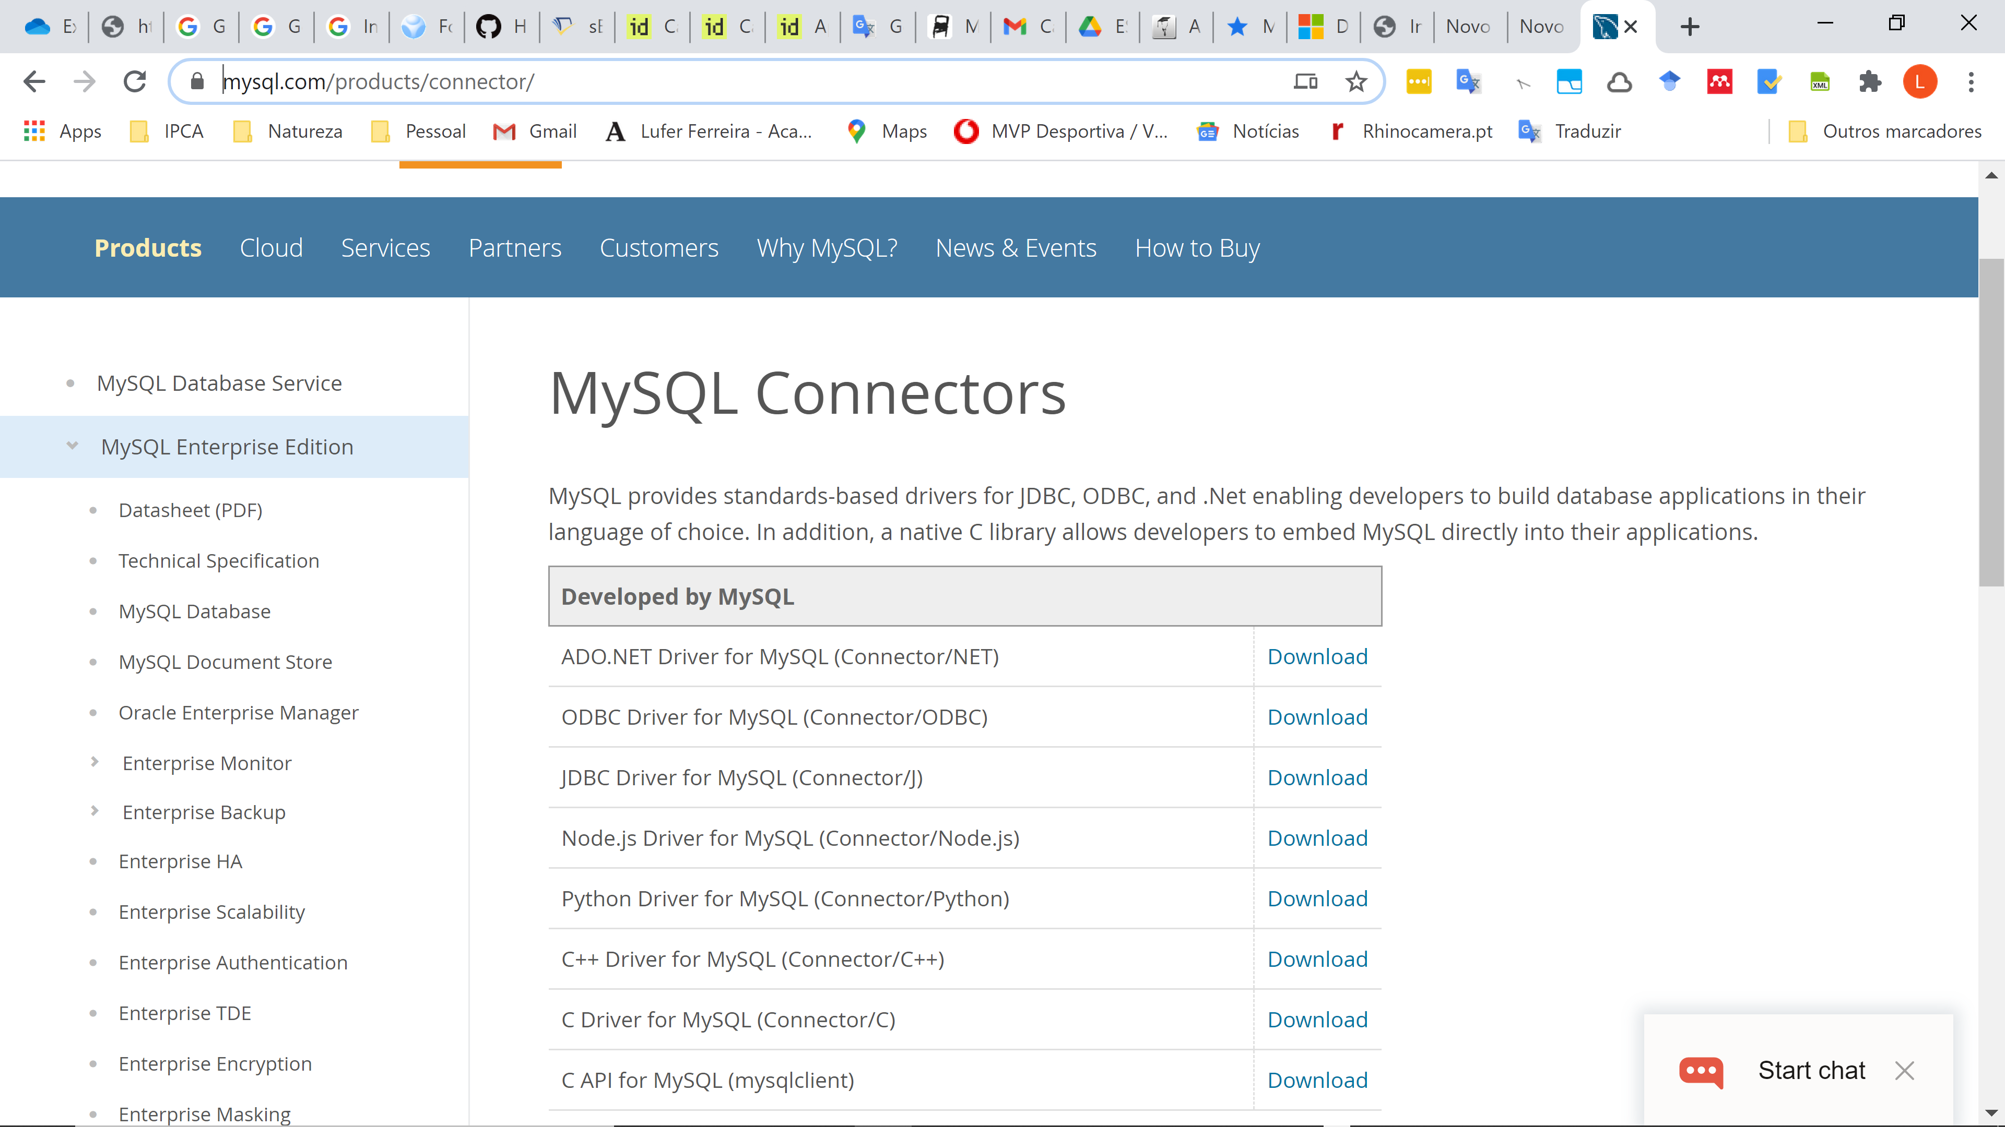
JDBC e ODBC Drivers reference - MySQL
MySQL Download: https://dev.mysql.com/downloads/installer/
Driver (conector) URL: https://www.mysql.com/products/connector/

Slide 23
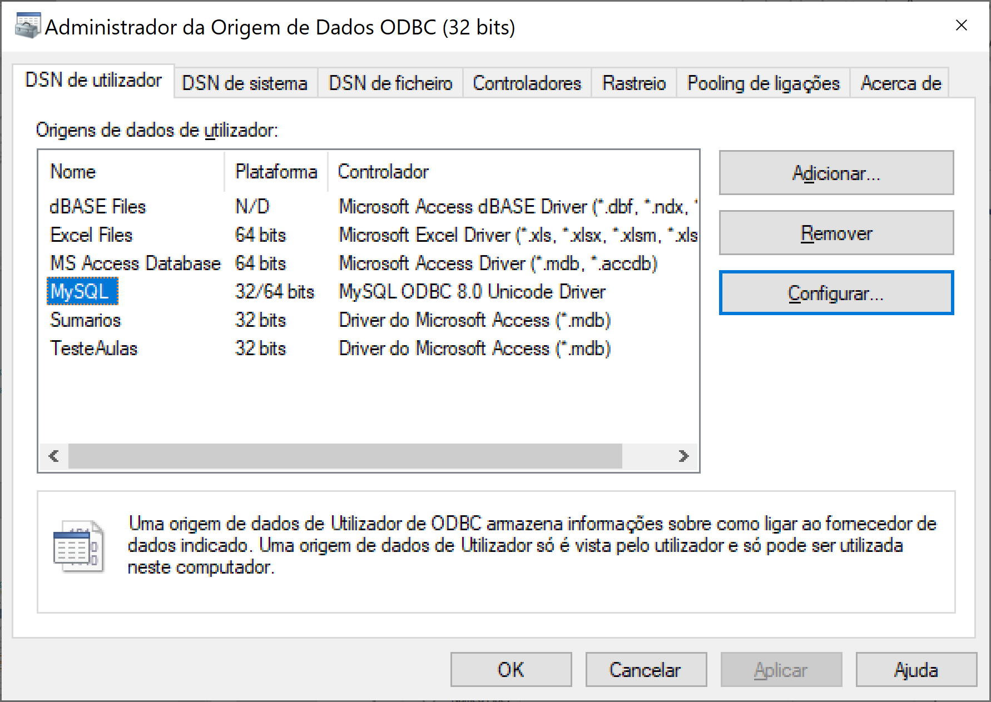
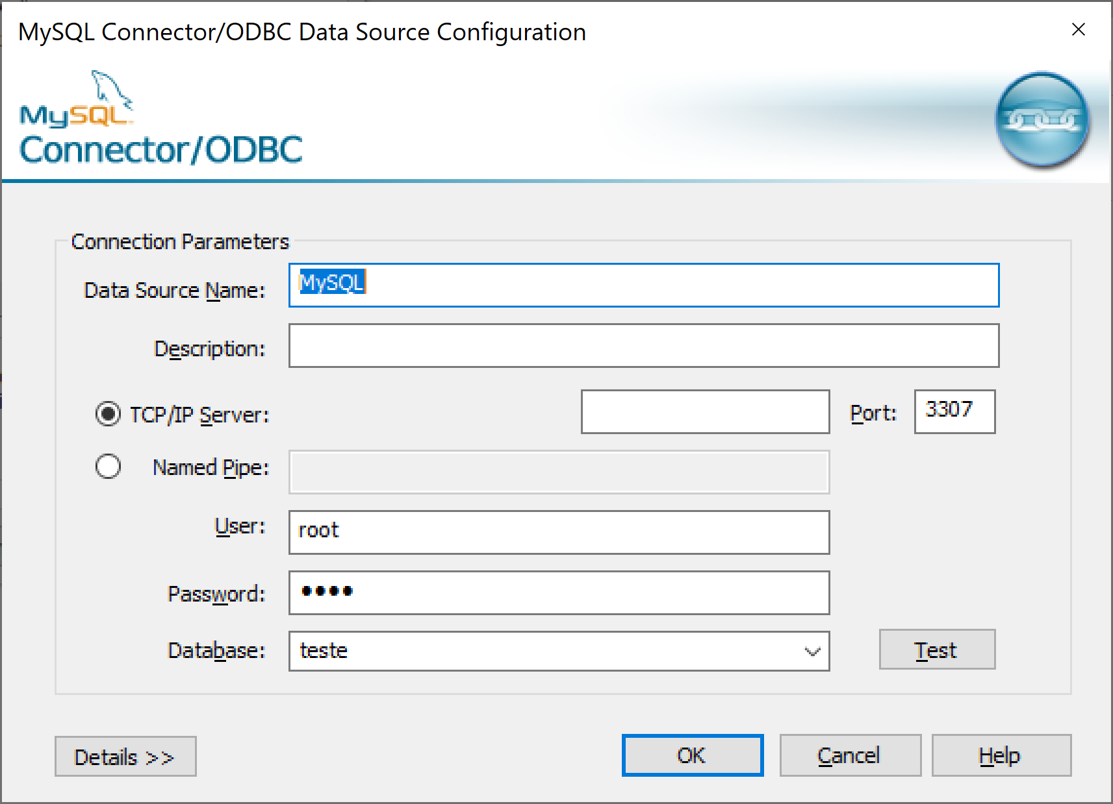
ODBC drivers reference - MySQL
MySQL Windows Connection

Slide 24
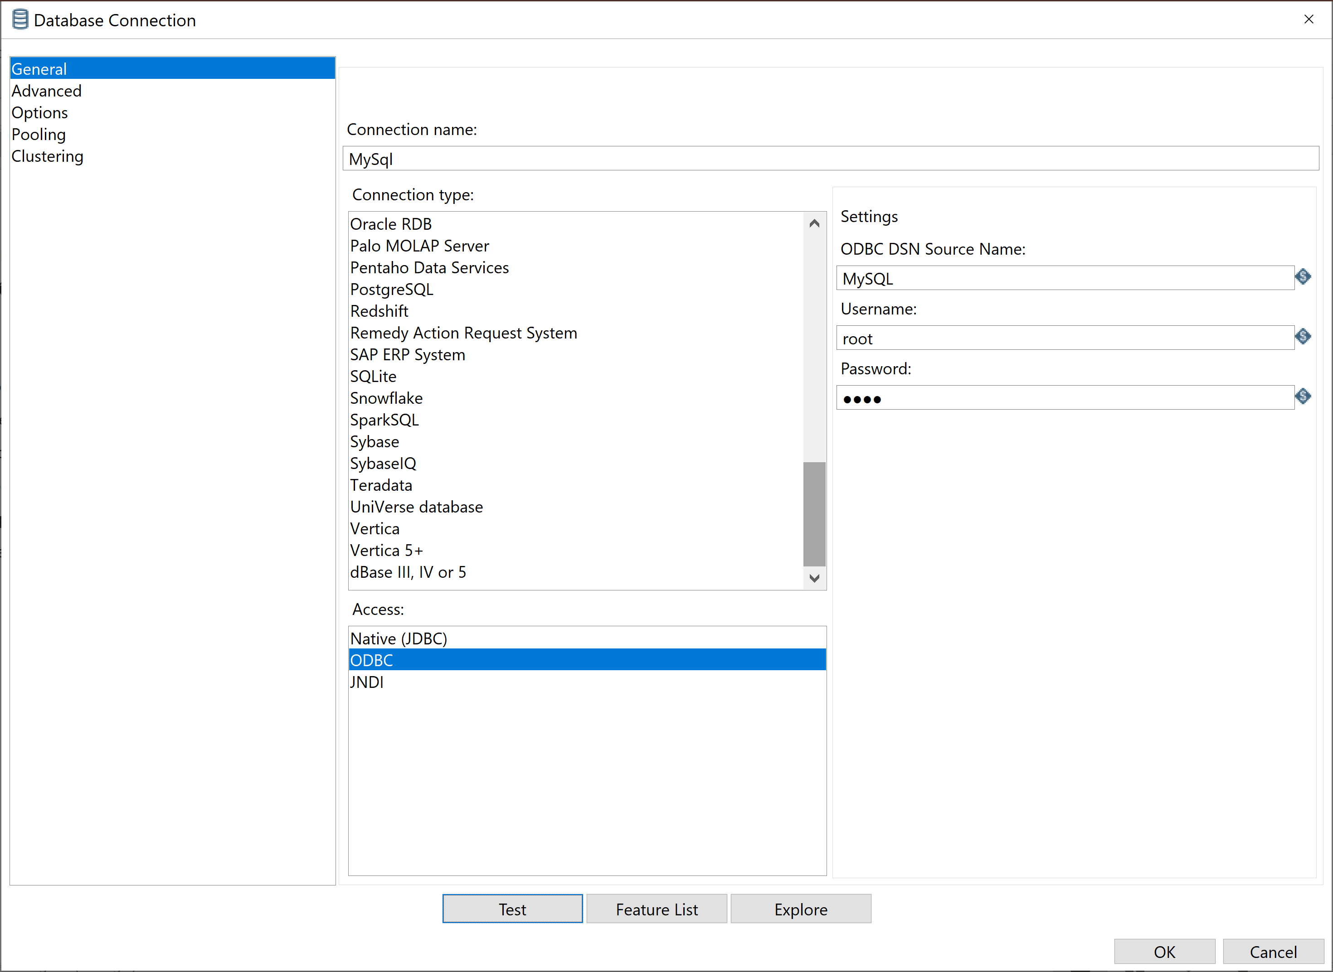
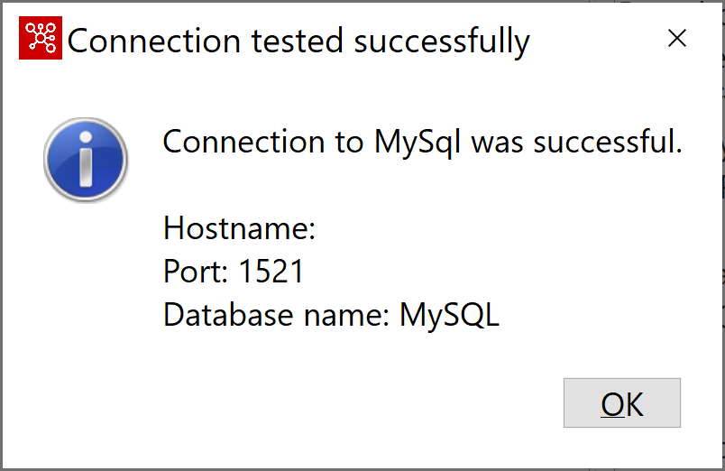
ODBC drivers reference - MySQL
MySQL Windows Connection
New Pentaho Connection

Slide 25
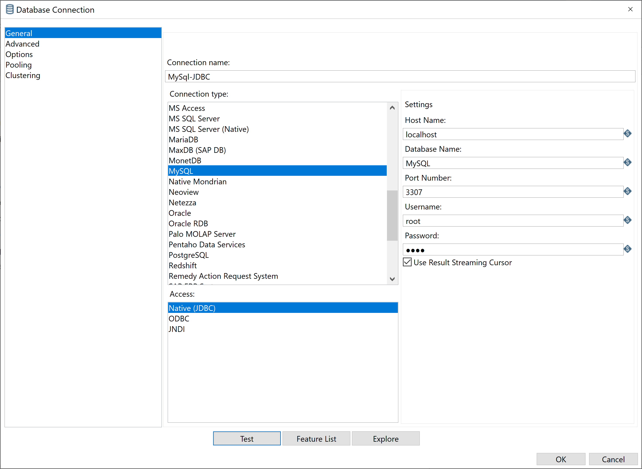
JDBC drivers reference - MySQL
MySQL JDBC Native Connection

Slide 26
JDBC Problems “'java.lang.ClassNotFoundException: sun.jdbc.odbc.JdbcOdbcDriver’”
Surgem com versão 8 JRE
Download jdbc.jar (https://community.yellowfinbi.com/attachments/299?token=5d2fdc926218f4afe6a6753ccbb27db3.jar)
Copiar “.jar” para a pasta java/jre8/lib/ext
Download jdbcOdbc.dll (https://www.dll-files.com/jdbcodbc.dll.html )
Copiar jdbcOdbc.dll para java/jre8/bin

Slide 27
JDBC Problems
https://community.yellowfinbi.com/knowledge-base/article/moving-the-jdbc-odbc-bridge-from-java-7-to-java-8
https://www.dll-files.com/download/deb26d75e3f3eab179b627badc322eb8/jdbcodbc.dll.html?c=R2hoL011NkdWek05RTFGd0pFdlVYUT09

Slide 28
JDBC – MySQL References
http://holowczak.com/installing-mysql-jdbc-drivers-in-pentaho-data-integration-and-ba-server-tools/2/
http://holowczak.com/installing-mysql-jdbc-drivers-in-pentaho-data-integration-and-ba-server-tools/3/
Exemplos:
http://holowczak.com/building-etl-transformations-in-pentaho-data-integration-kettle/

